Slide 1

HOUSING: PRICE PREDICTION
Prepared by:
Maahi Gurnani, Data Science Intern at Flip Robo Technologies

Slide 2
INTRODUCTION
Problem Statement:
Houses are one of the necessary needs of each and every person around the globe and therefore housing and real estate market is one of the markets which is one of the major contributors in the world’s economy.
Data science comes as a very important tool to solve problems in the domain to help the companies increase their overall revenue, profits, improving their marketing strategies and focusing on changing trends in house sales and purchases.
A US-based housing company named Surprise Housing has decided to enter the Australian market.
The company is looking at prospective properties to buy houses to enter the market. We are required to build a model using Machine Learning in order to predict the actual value of the prospective properties and decide whether to invest in them or not. For this company wants to know:
• Which variables are important to predict the price of variable?
• How do these variables describe the price of the house?

Slide 3
Business Goal
Problem Statement:
We are required to model the price of houses with the available independent variables.
This model will then be used by the management to understand how exactly the prices vary with the variables.
They can accordingly manipulate the strategy of the firm and concentrate on areas that will yield high returns.
Further, the model will be a good way for the management to understand the pricing dynamics of a new market.

Slide 4
Mathematical/ Analytical Modelling of the Problem
Regression Model: Regression models are often used to determine which independent variables hold the most influence overdependent variables information that can be leveraged to make essential decision.
The most traditional regression models are:
Linear Regression with Lasso and Ridge
Decision Tree Regression,
Random Forest regression
AdaBoost Regression
Support Vector Regression
K Neighbors Regression
Gradient Boosting Regression
The ‘r2’ score will be used to determine the best model amongst the above mentioned

Slide 5
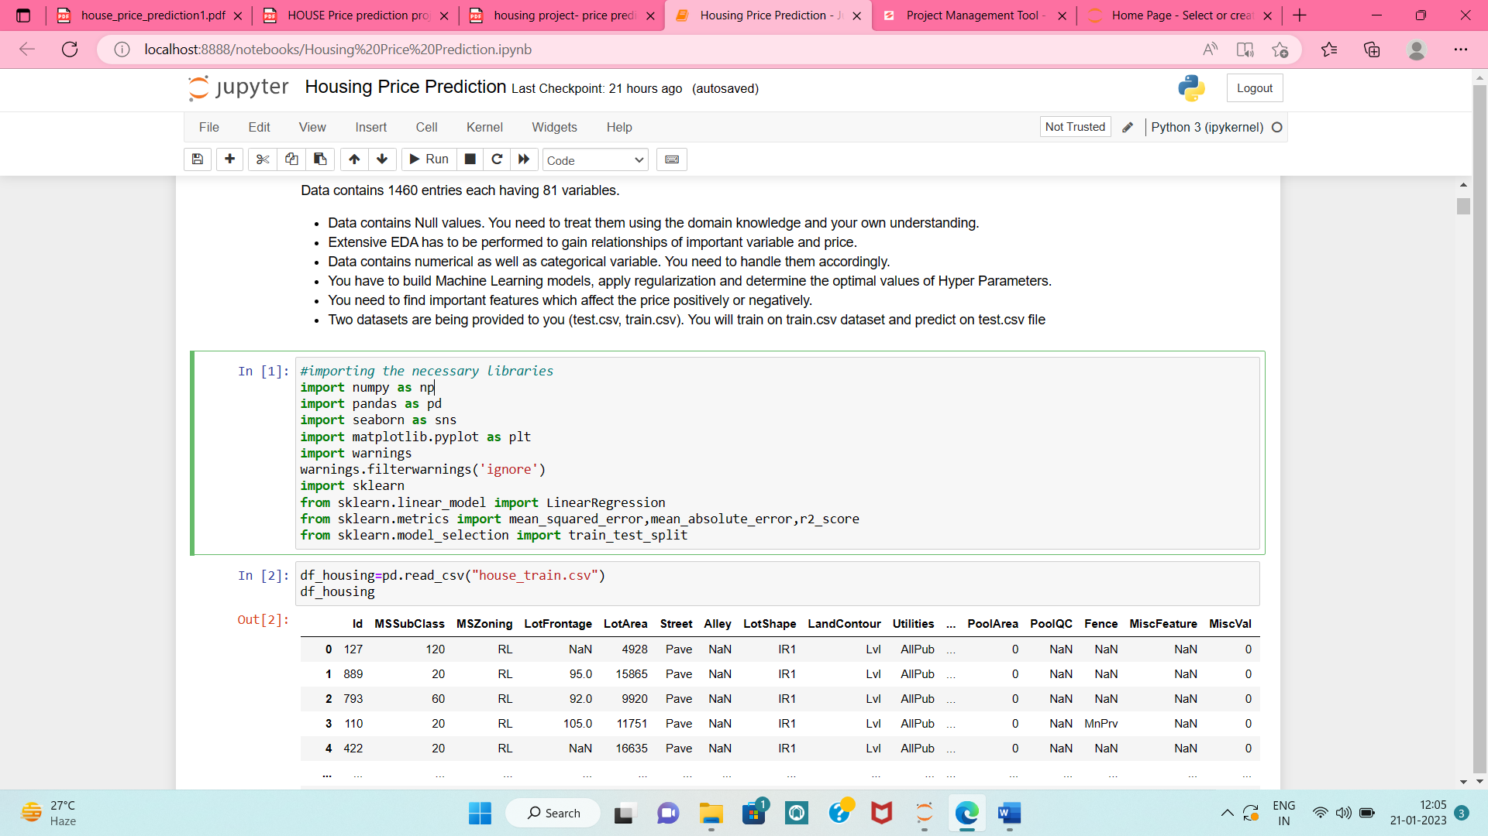
Hardware and Software Requirements and Tools Used
Languages Used: Python
Platform Used: Jupyter Notebook
Libraries and Metrics used:
Following are the libraries and metrics used to start the Regression Model

Slide 6
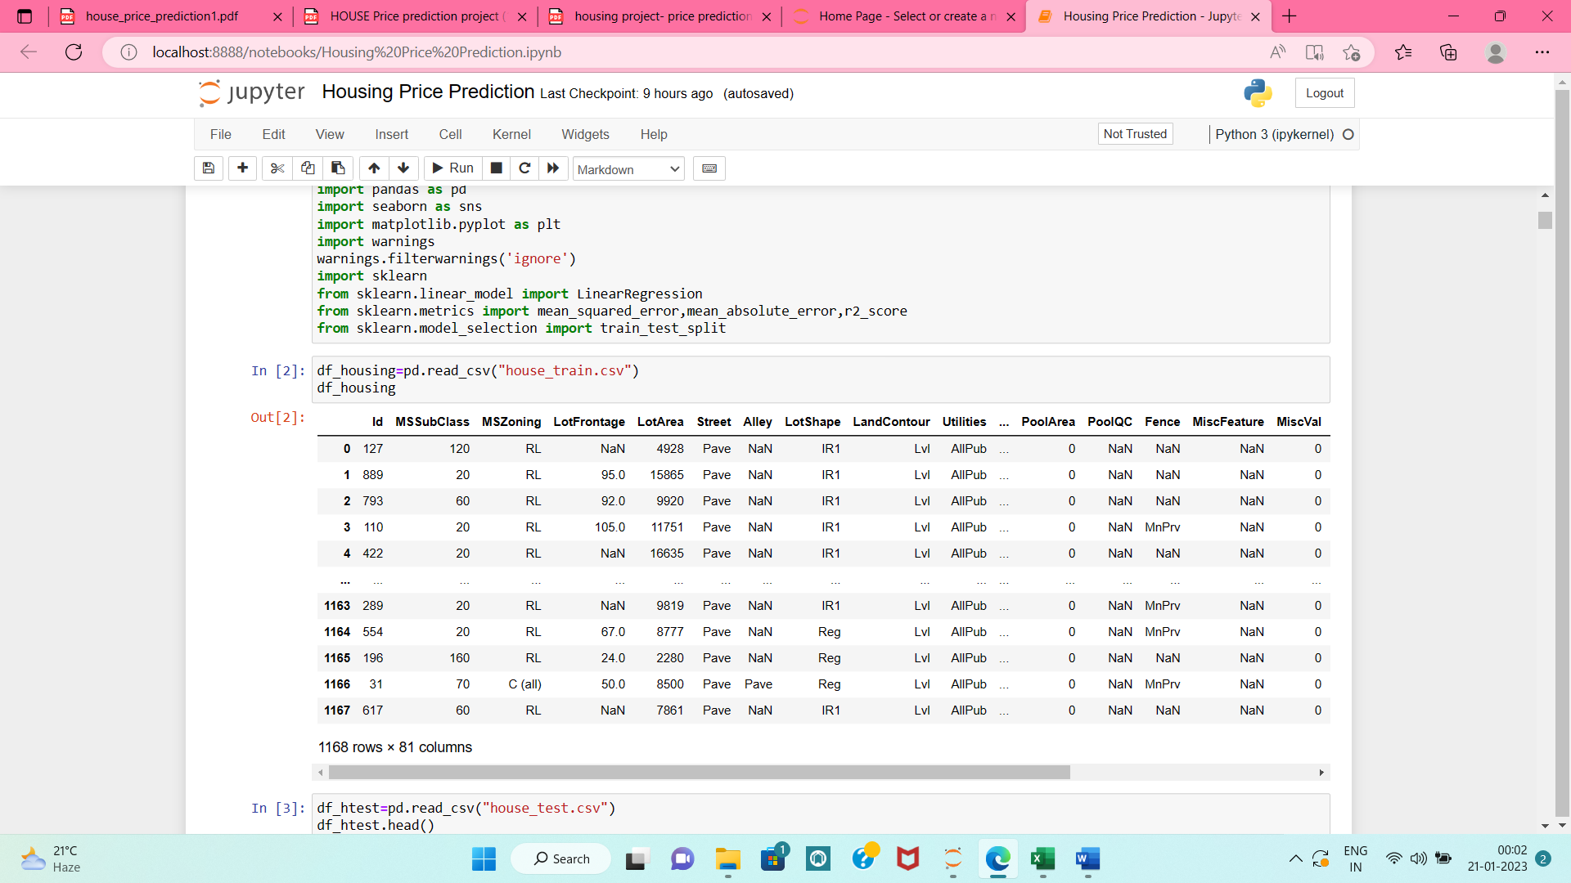
Data Sources
The US Based company has collected a data set from the sale of houses in Australia. This dataset is been provided in the CSV file to us.
Dataset contains 1460 entries each having 81 variables.

Slide 7
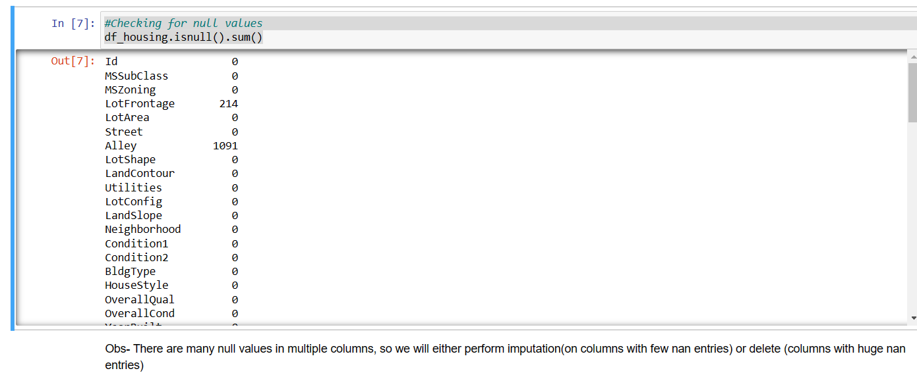
Data Pre-processing
1. Checking for null values: df_housing.isnull().sum()

Slide 8
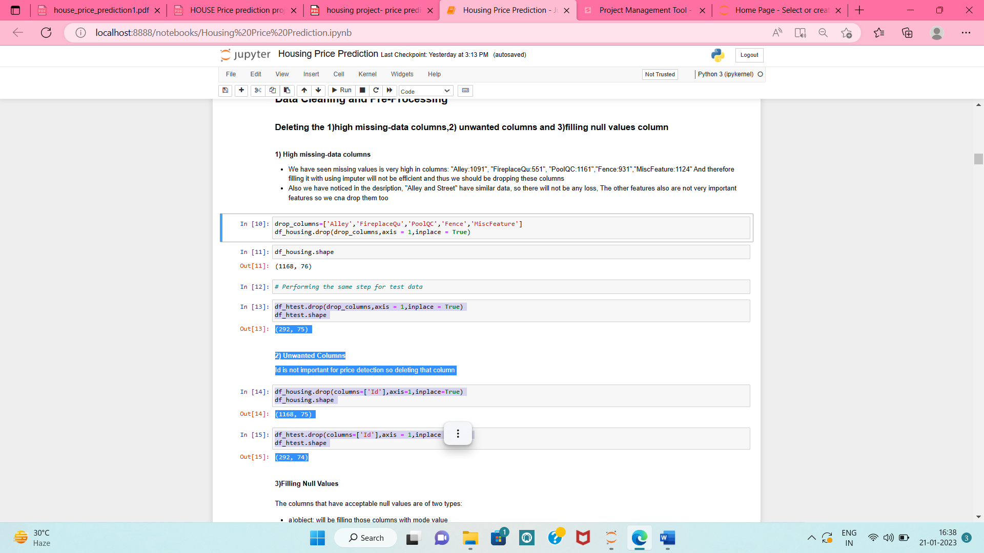
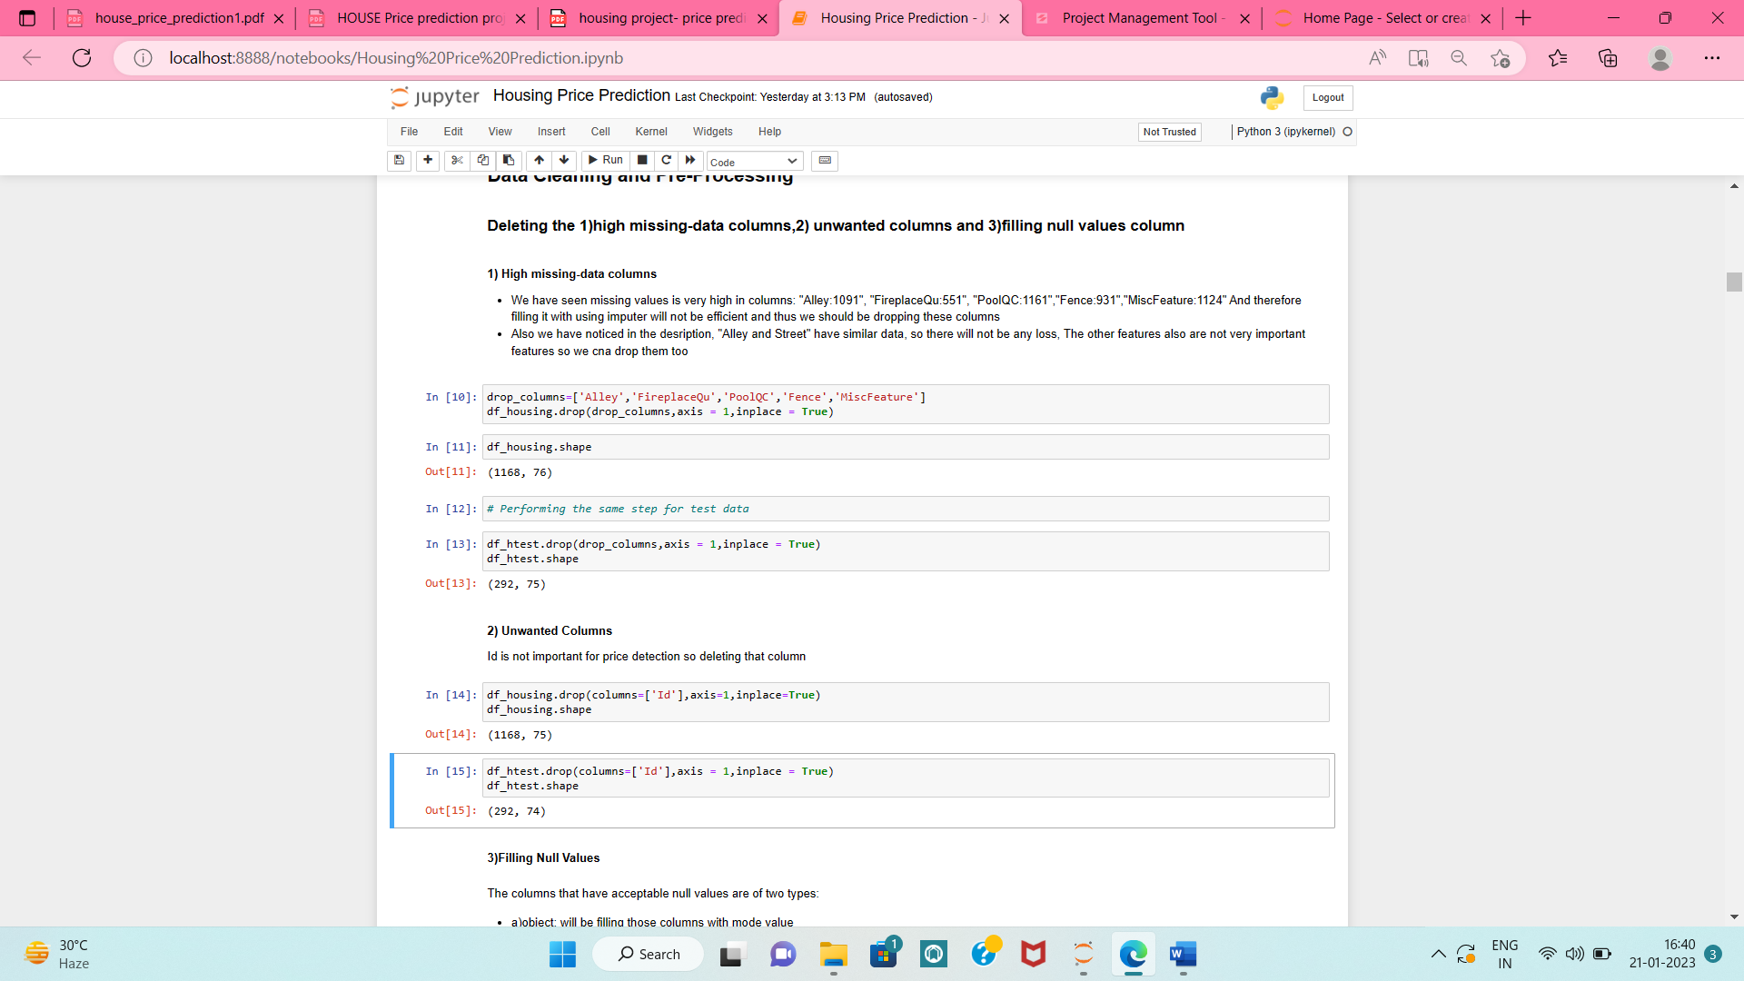
2. Deleting the: 1)high missing-data columns, 2) unwanted columns
1) Highly Missing data
2) Unwanted Columns

Slide 9
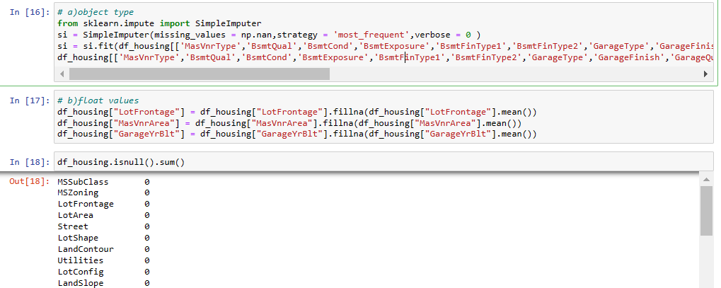
3. Filling Null Values Columns:
1) object: will be filling those columns with mode value
2) float: will be filling those columns with mean value

Slide 10
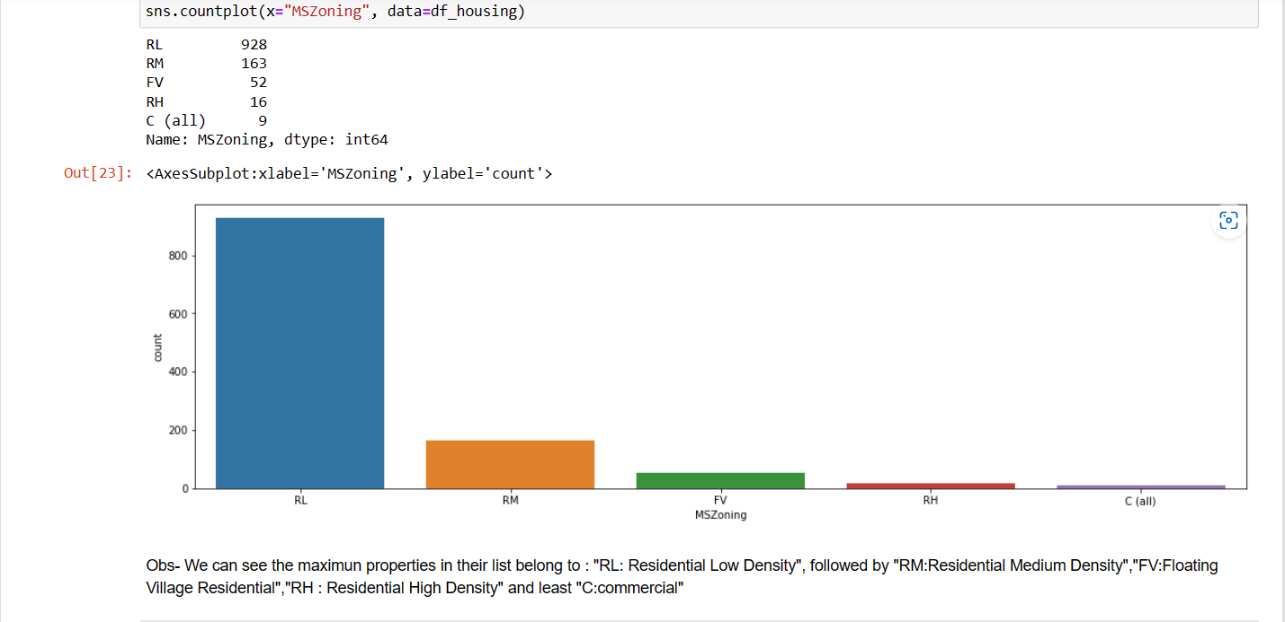
Data Visualization (Univariate Analysis)
1) Count Plots to check the percentage of unique attributes

Slide 11
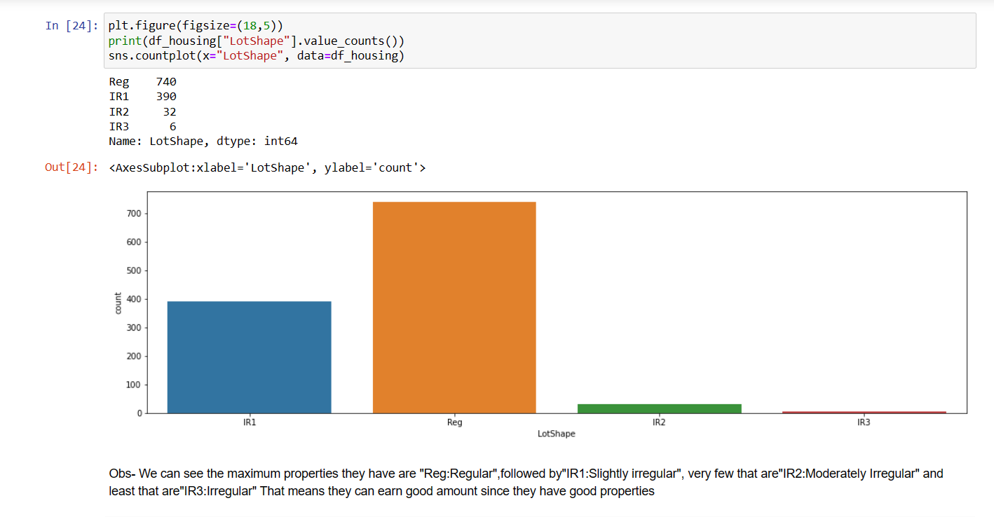

Slide 12
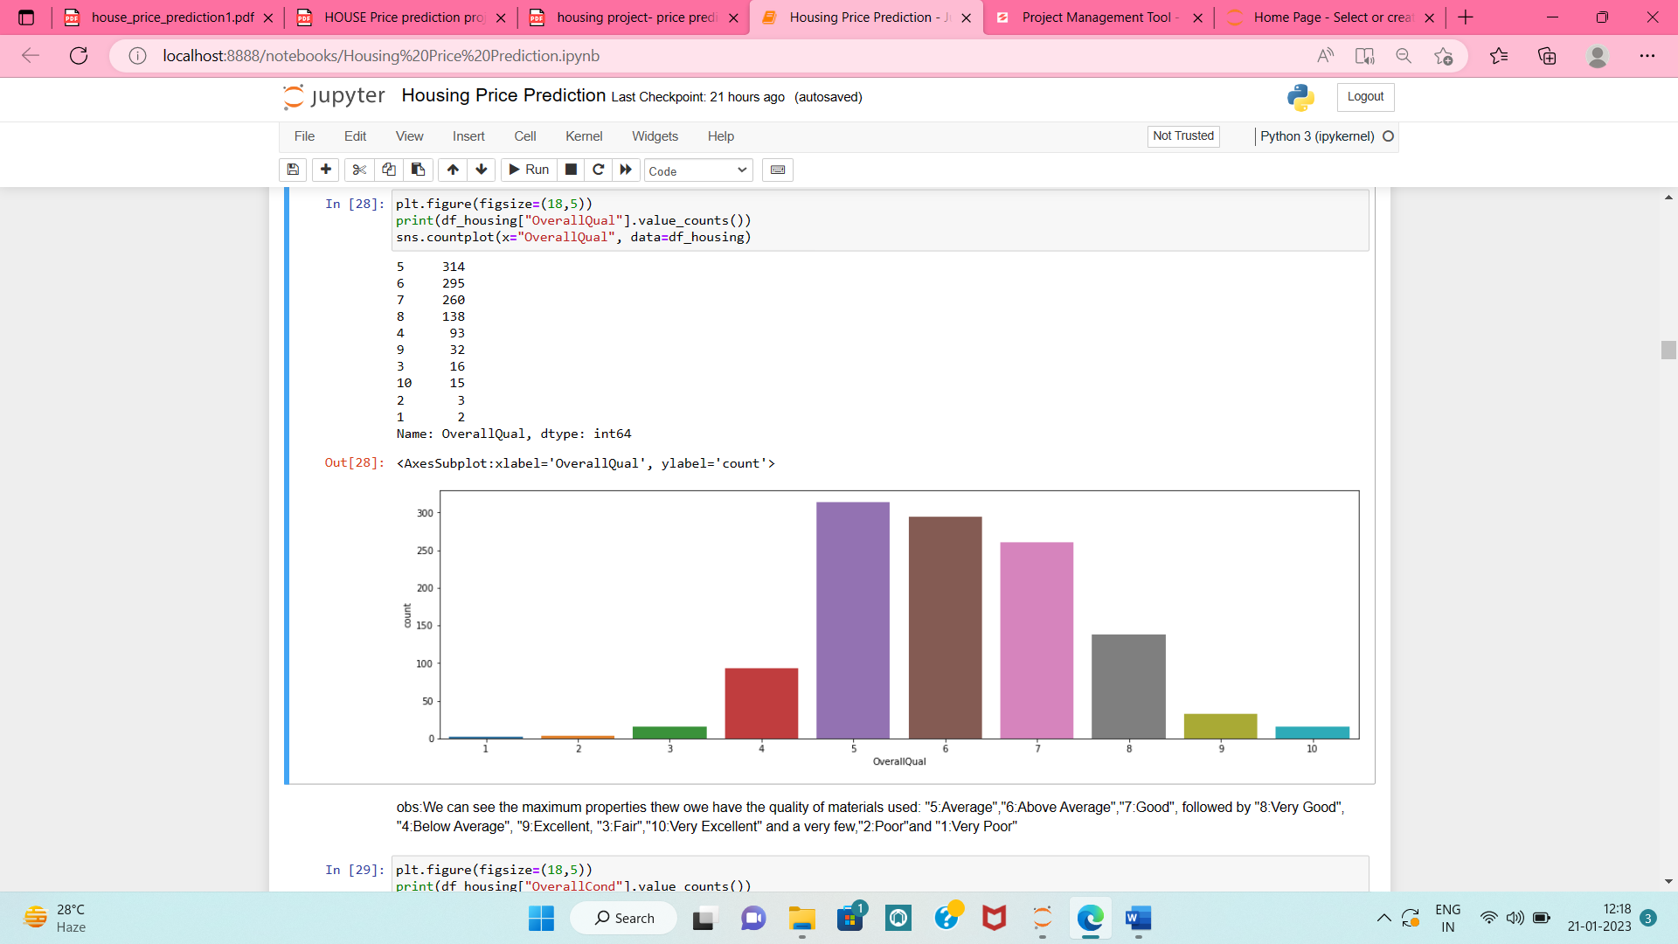

Slide 13
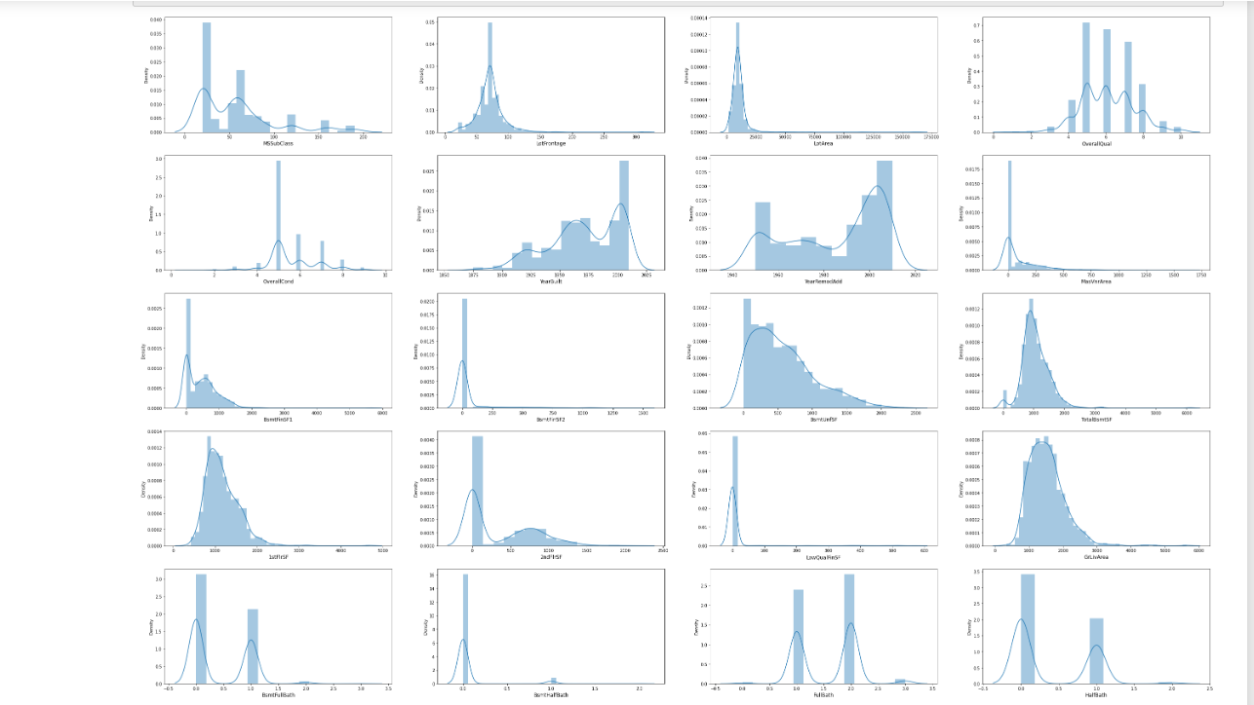
Data Visualization (Univariate Analysis)
b) Distribution Plot to check skewness in columns:

Slide 14
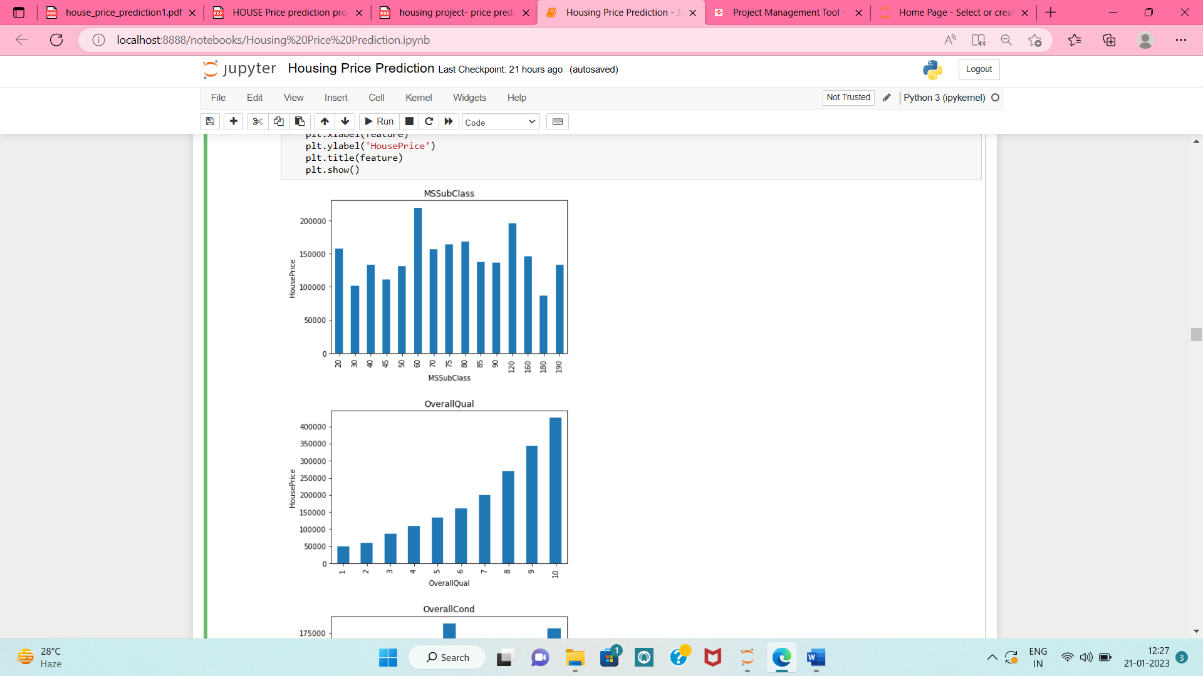
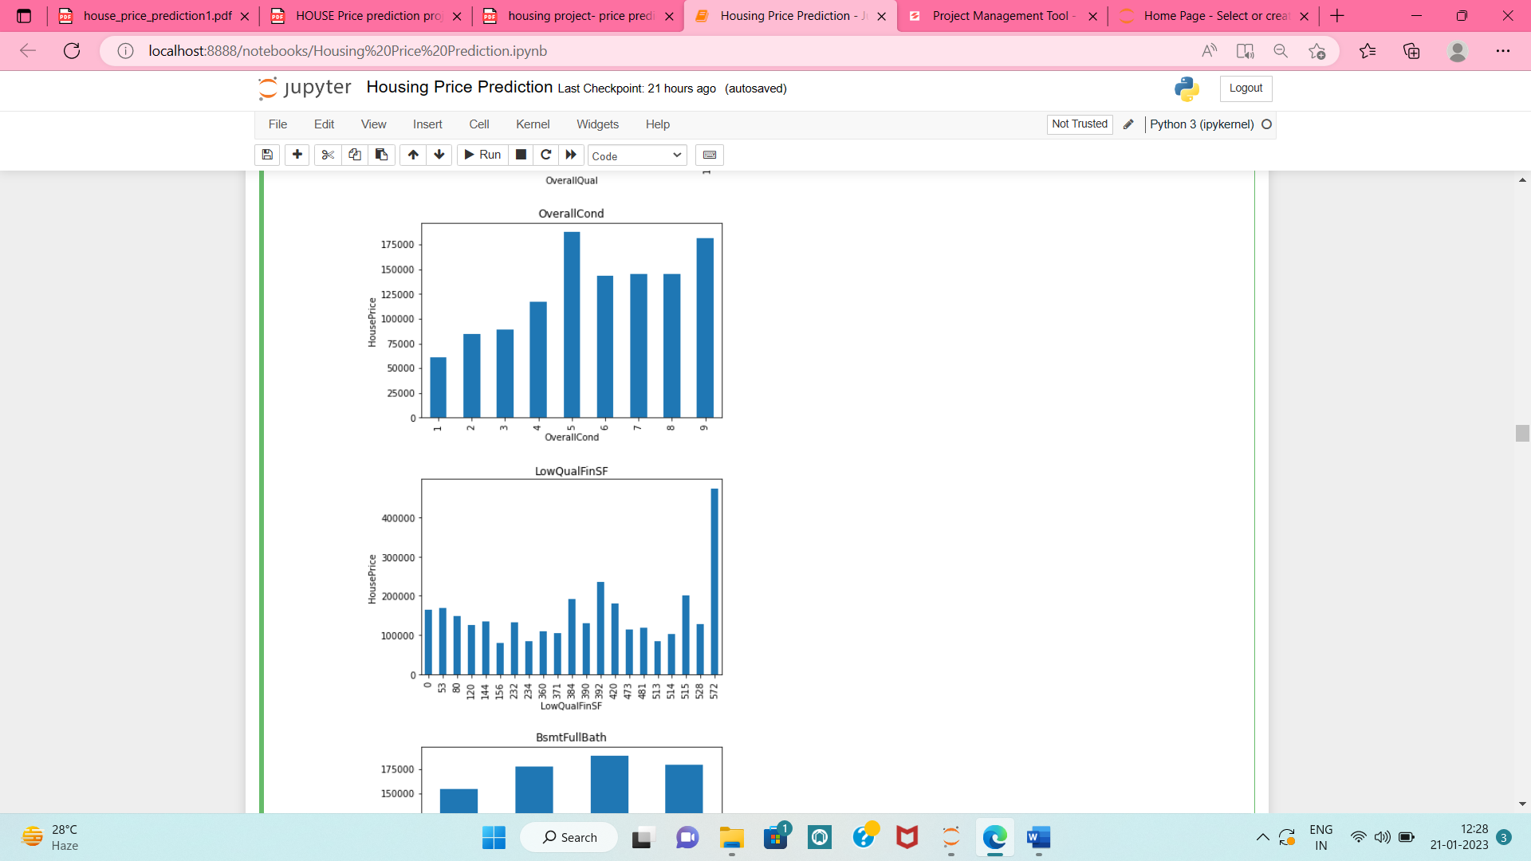
Data Visualization (Bivariate Analysis)
a) All numeric variables with unique count<25 vs House Price

Slide 15
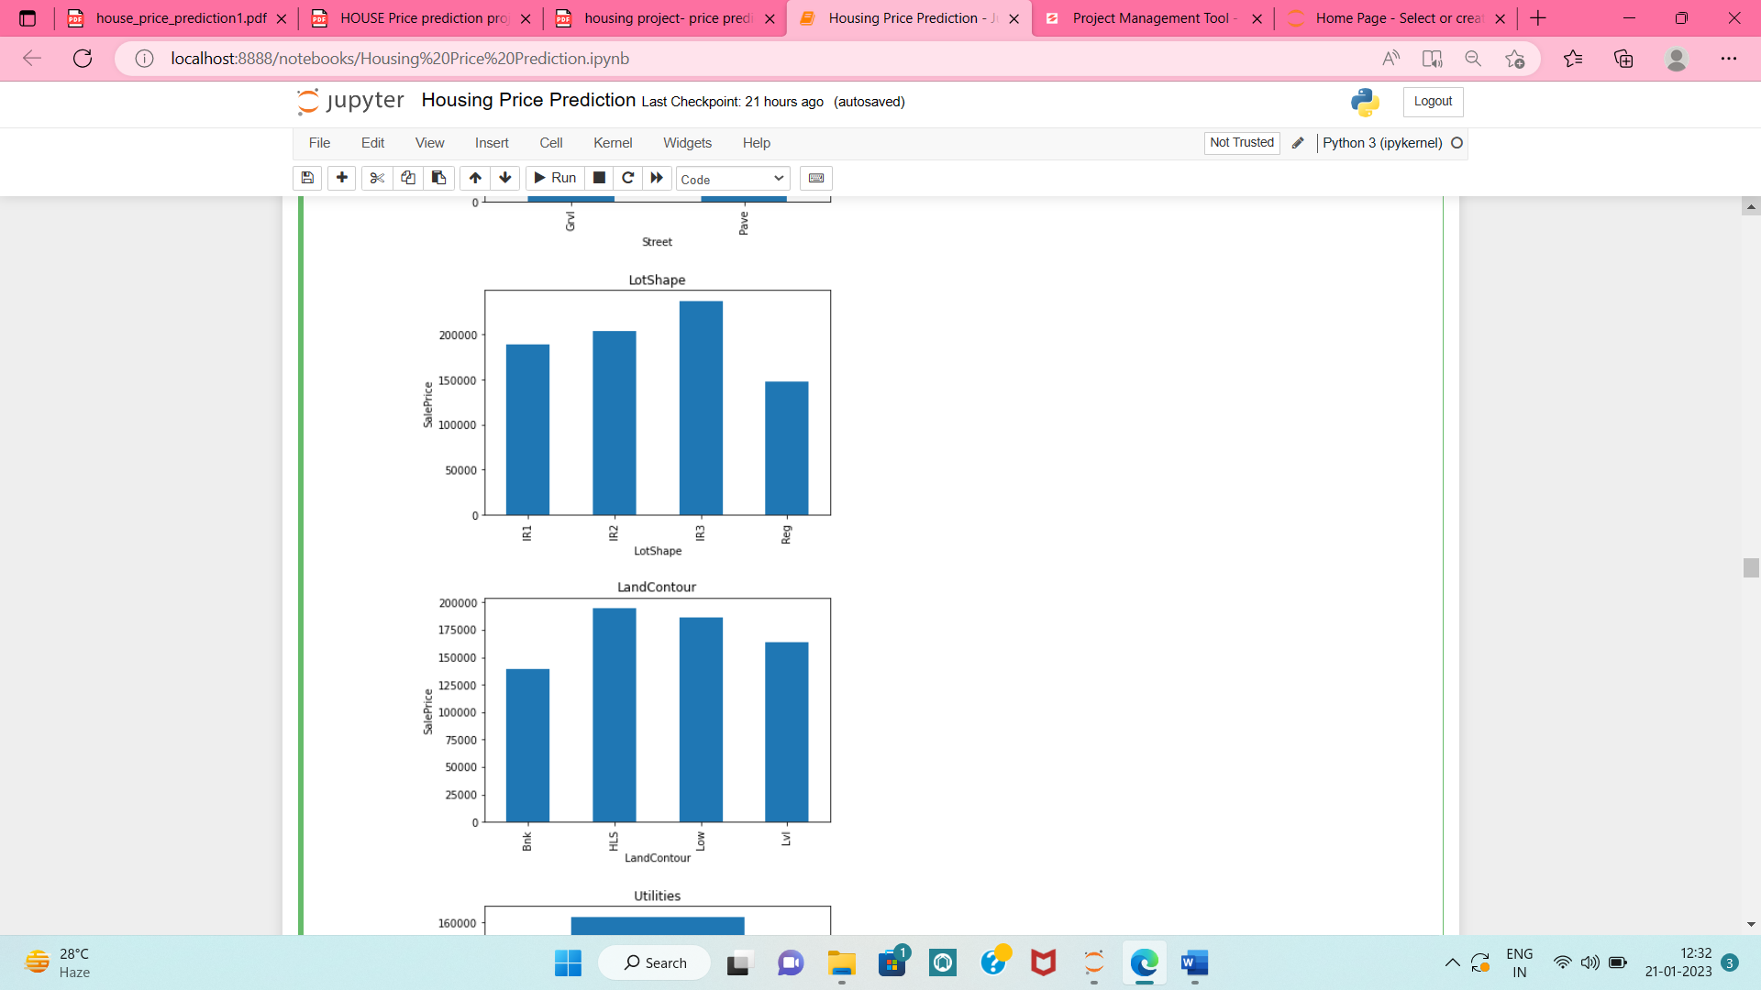
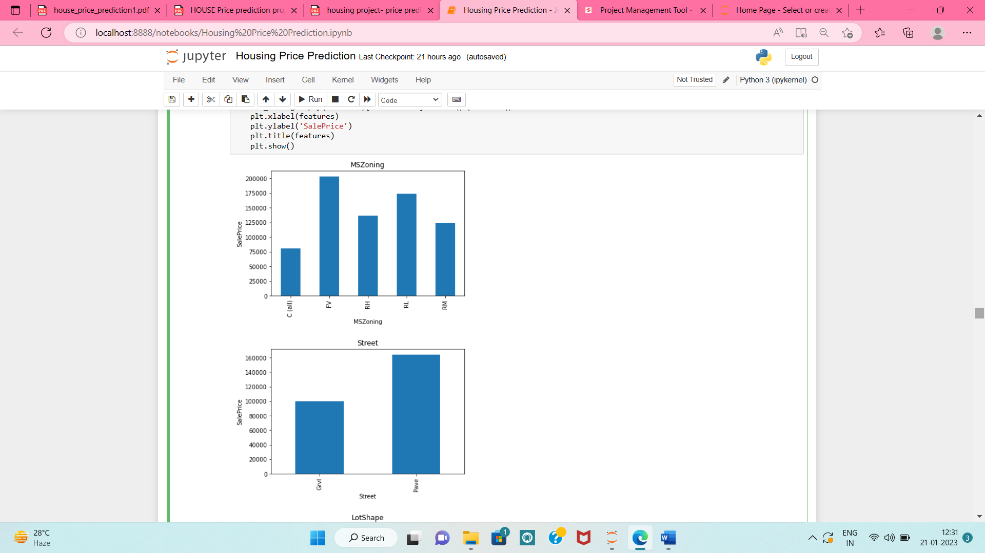
Data Visualization (Univariate Analysis)
b) Categorical variables vs SalesPrice

Slide 16
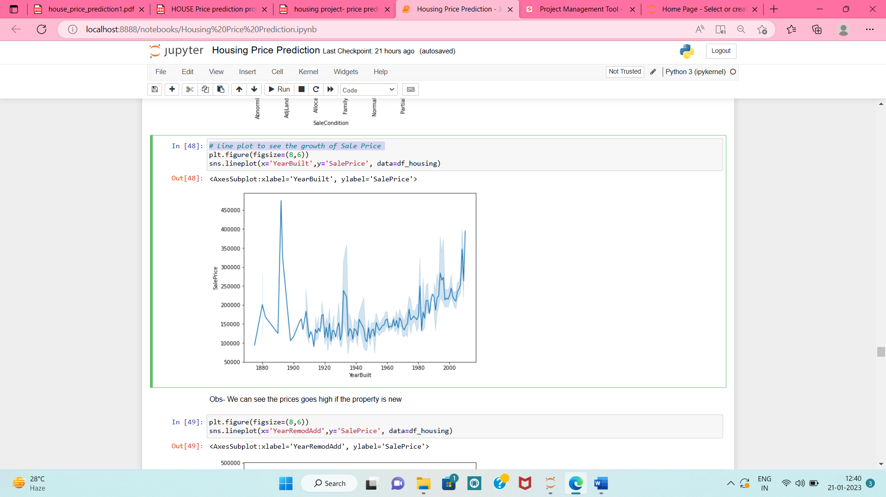
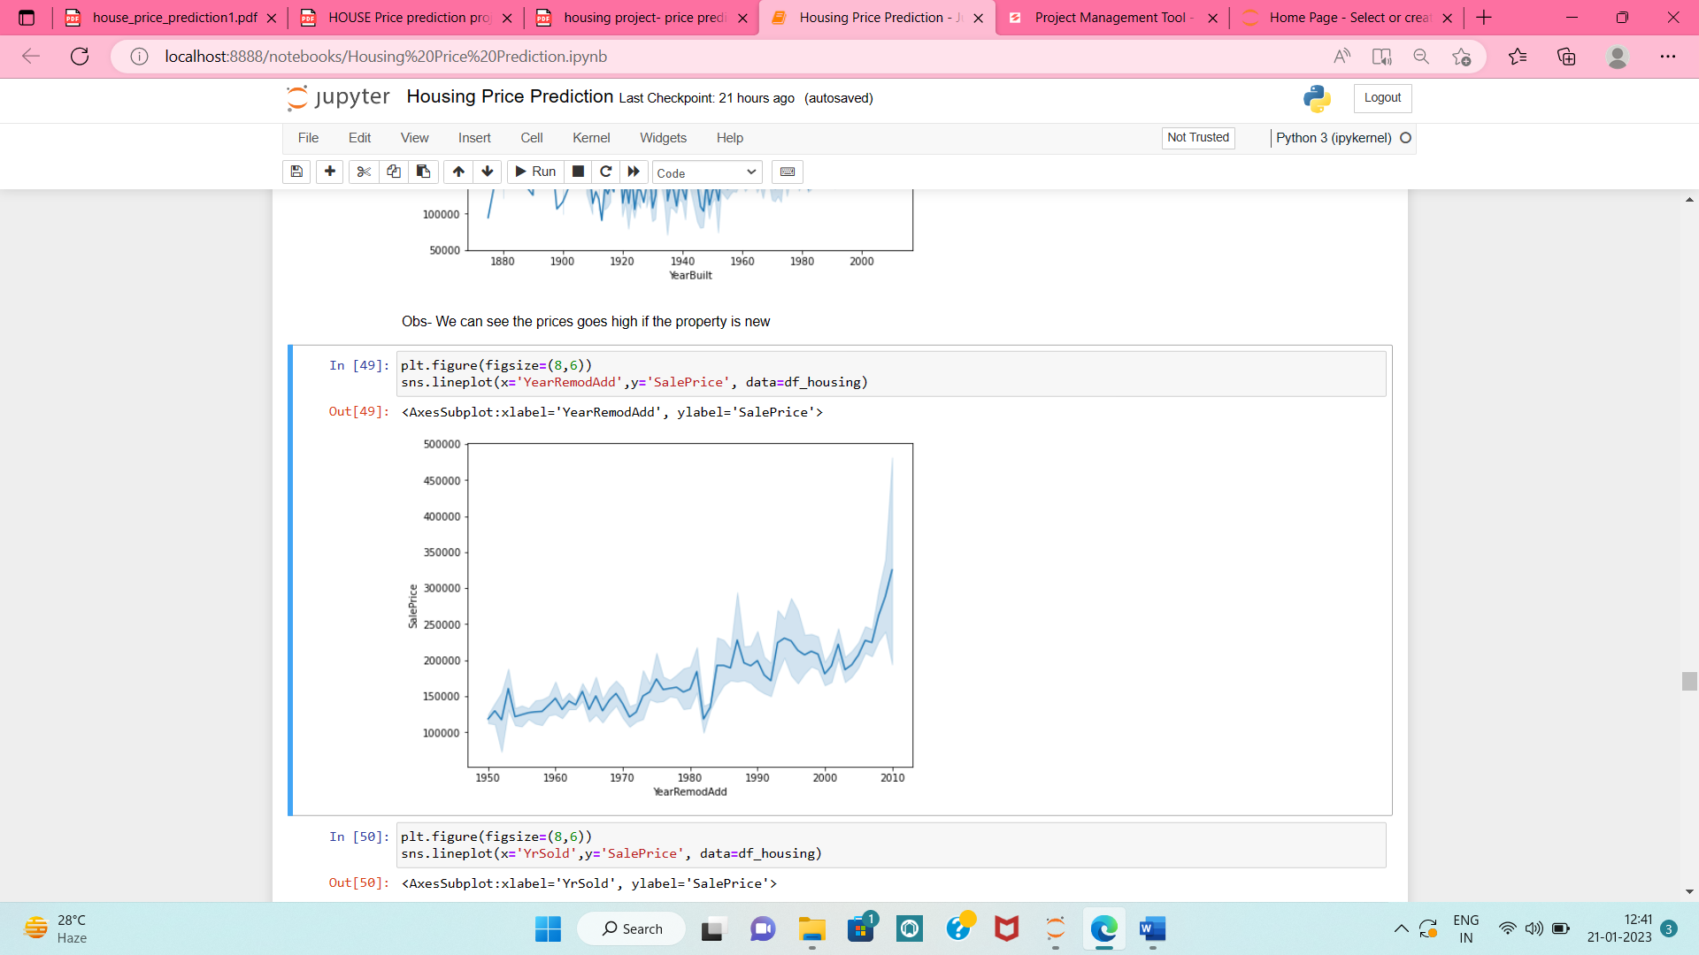
Data Visualization (Univariate Analysis)
c) Line plot to see the growth of Sale Price

Slide 17
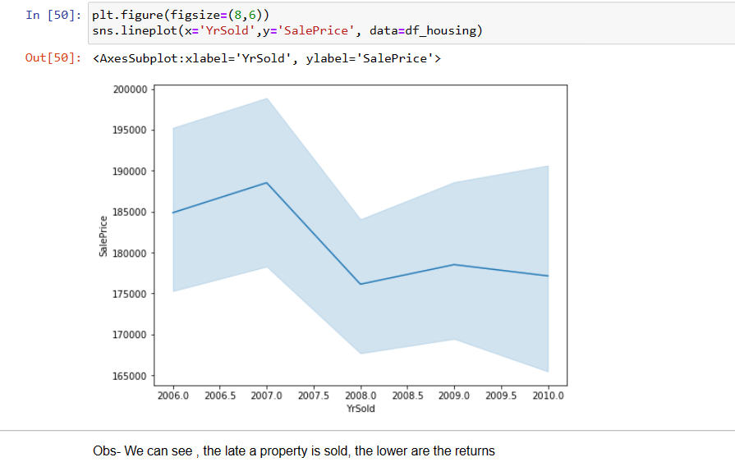

Slide 18
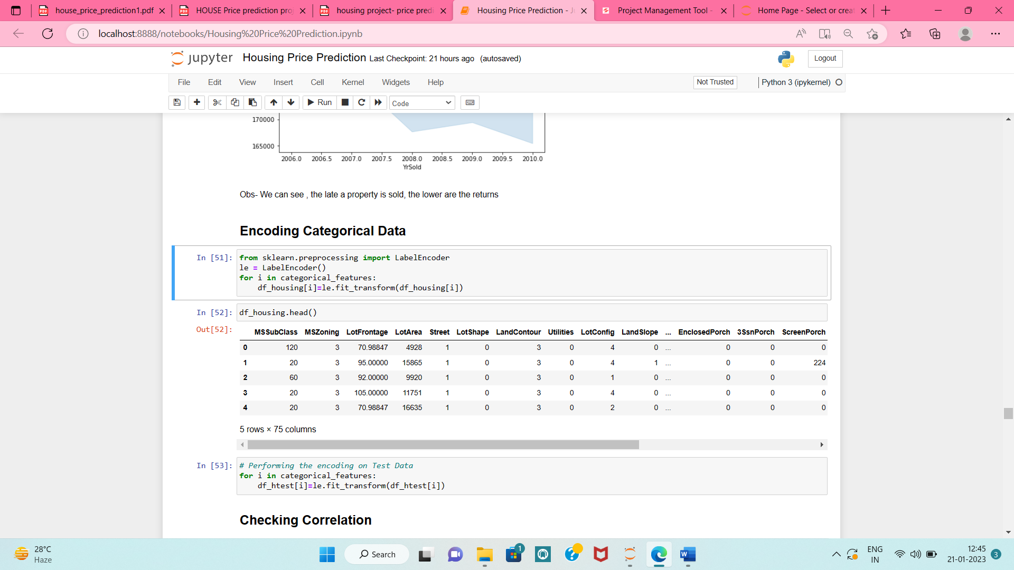
Model/s Development and Evaluation
a) Encoding Categorical Data

Slide 19
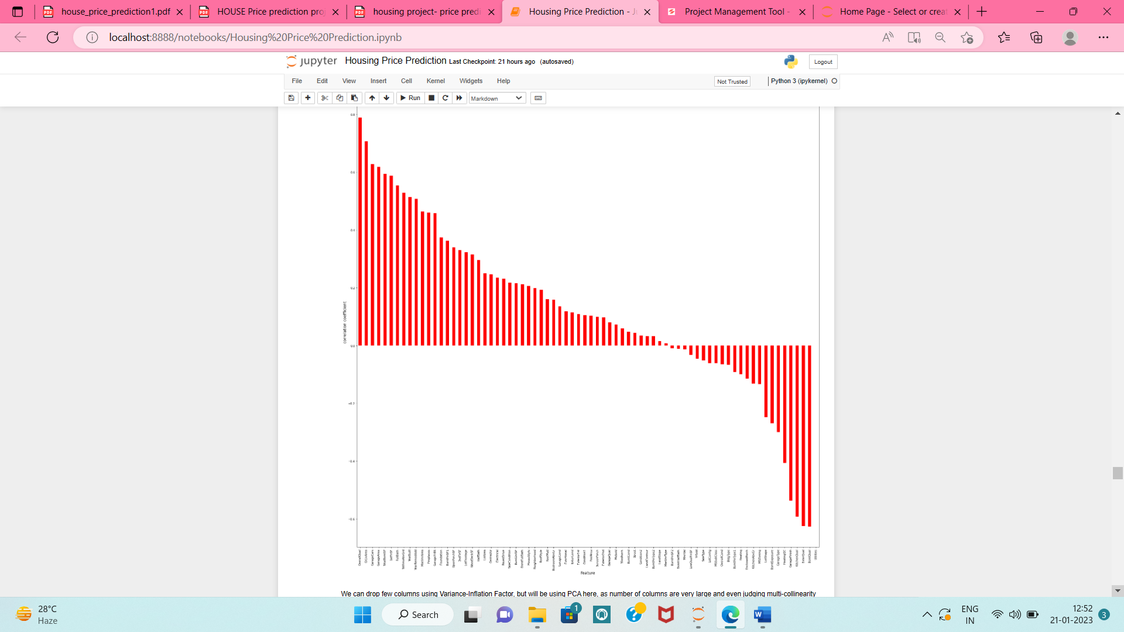
Model/s Development and Evaluation
b) Checking Correlation:

Slide 20
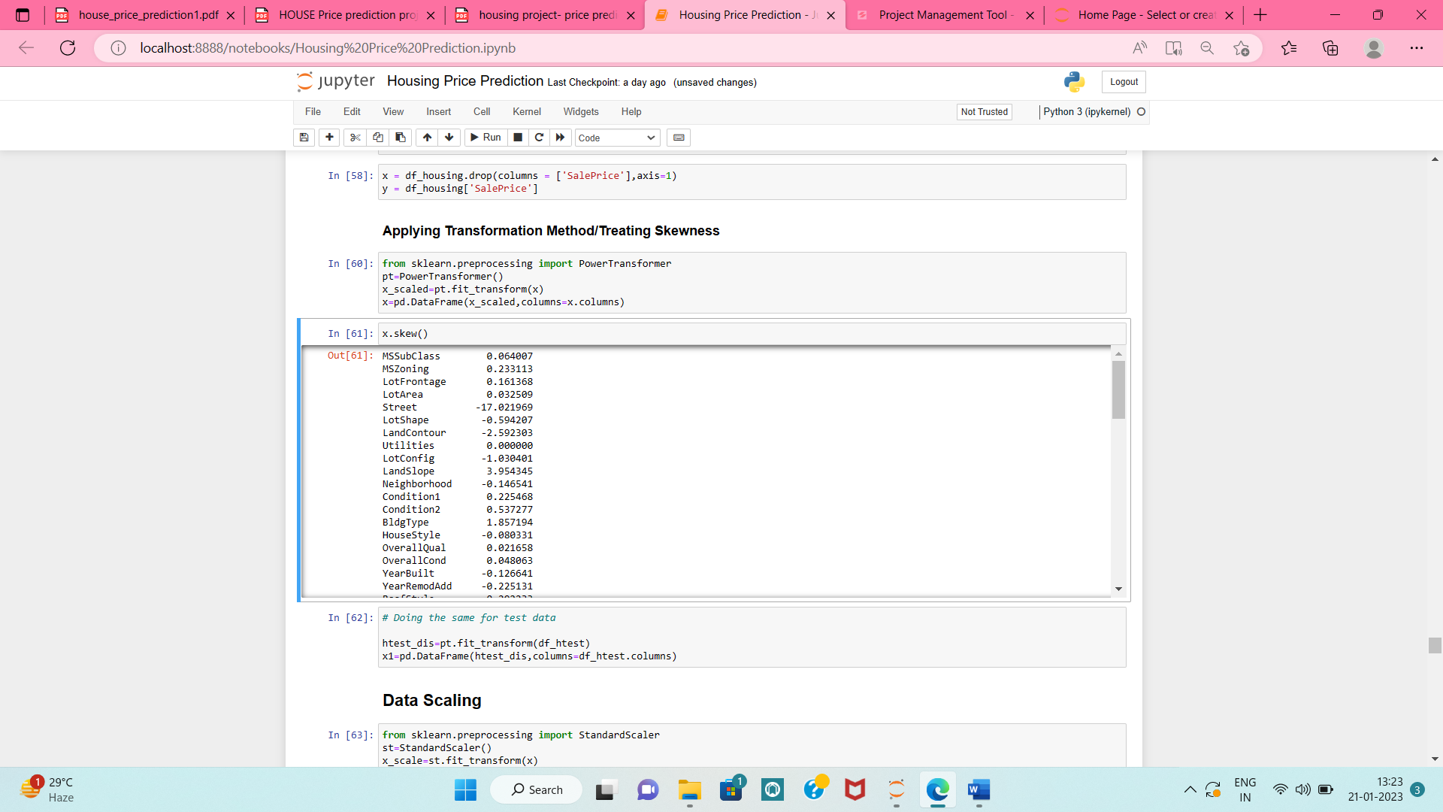
Model/s Development and Evaluation
c) Data Transformation: df_housing.skew()
d)Applying Transformation Method/Treating Skewness

Slide 21
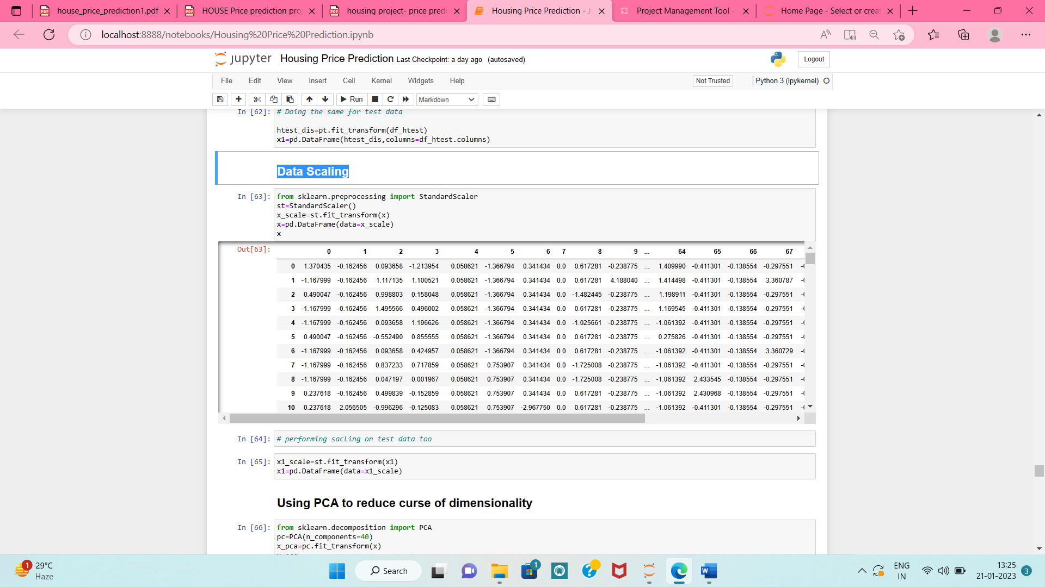
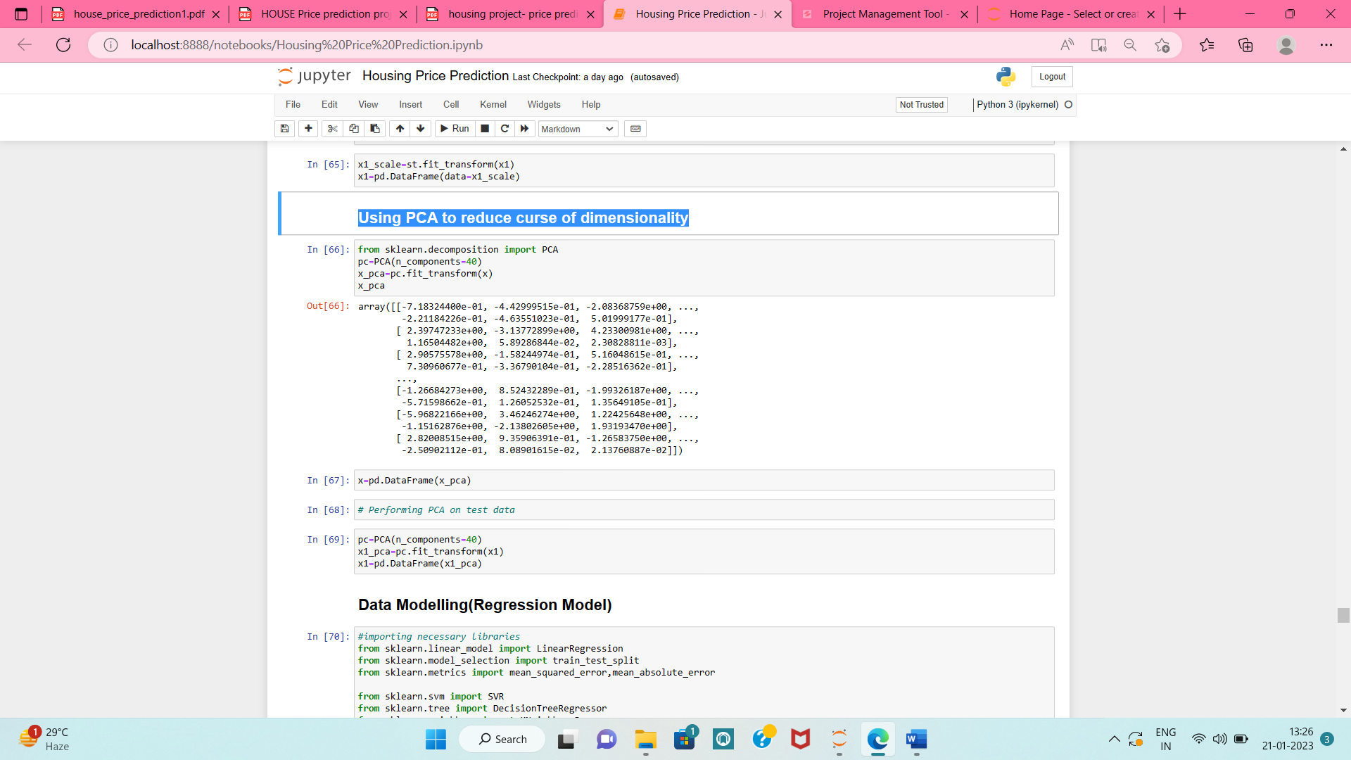
Model/s Development and Evaluation
e) Data Scaling:
f) Using PCA to reduce curse of dimensionality:

Slide 22
Modelling Approach
We have already mentioned our model would be a regression model.
For all of the techniques mentioned in the previous section (Linear Regression,Random Forest Regression, Decision Tree Regression, XGBoost, k-nearest neighbors(KNN) etc etc.), we will follow these steps to build a model:
• Choose an algorithm that implements the corresponding technique
• Search for an effective parameter combination for the chosen algorithm
• Create a model using the found parameters
• Train (fit) the model on the training dataset •
Test the model on the test dataset and get the results

Slide 23
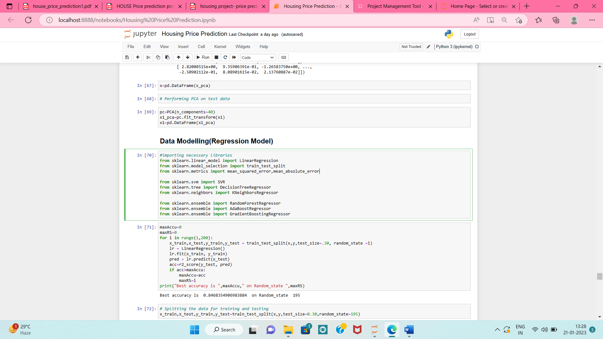
a) Regression Method

Slide 24
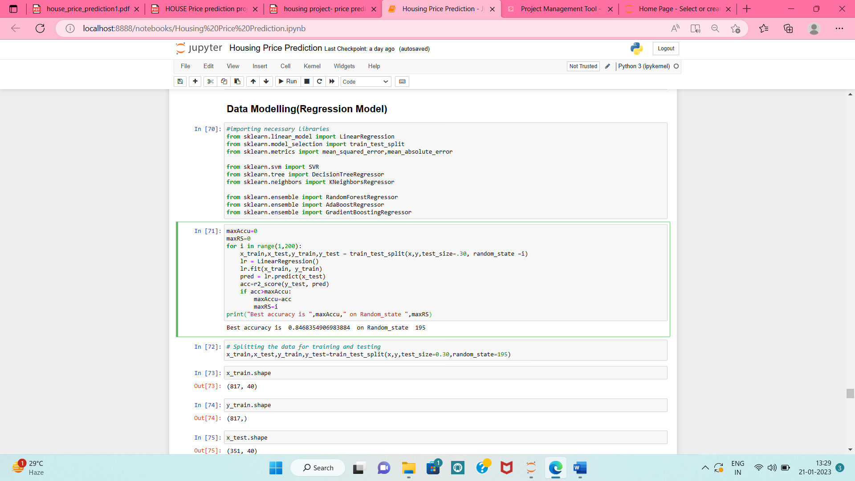
b) Finding Best Random State, and using it for splitting Train-Test Data

Slide 25
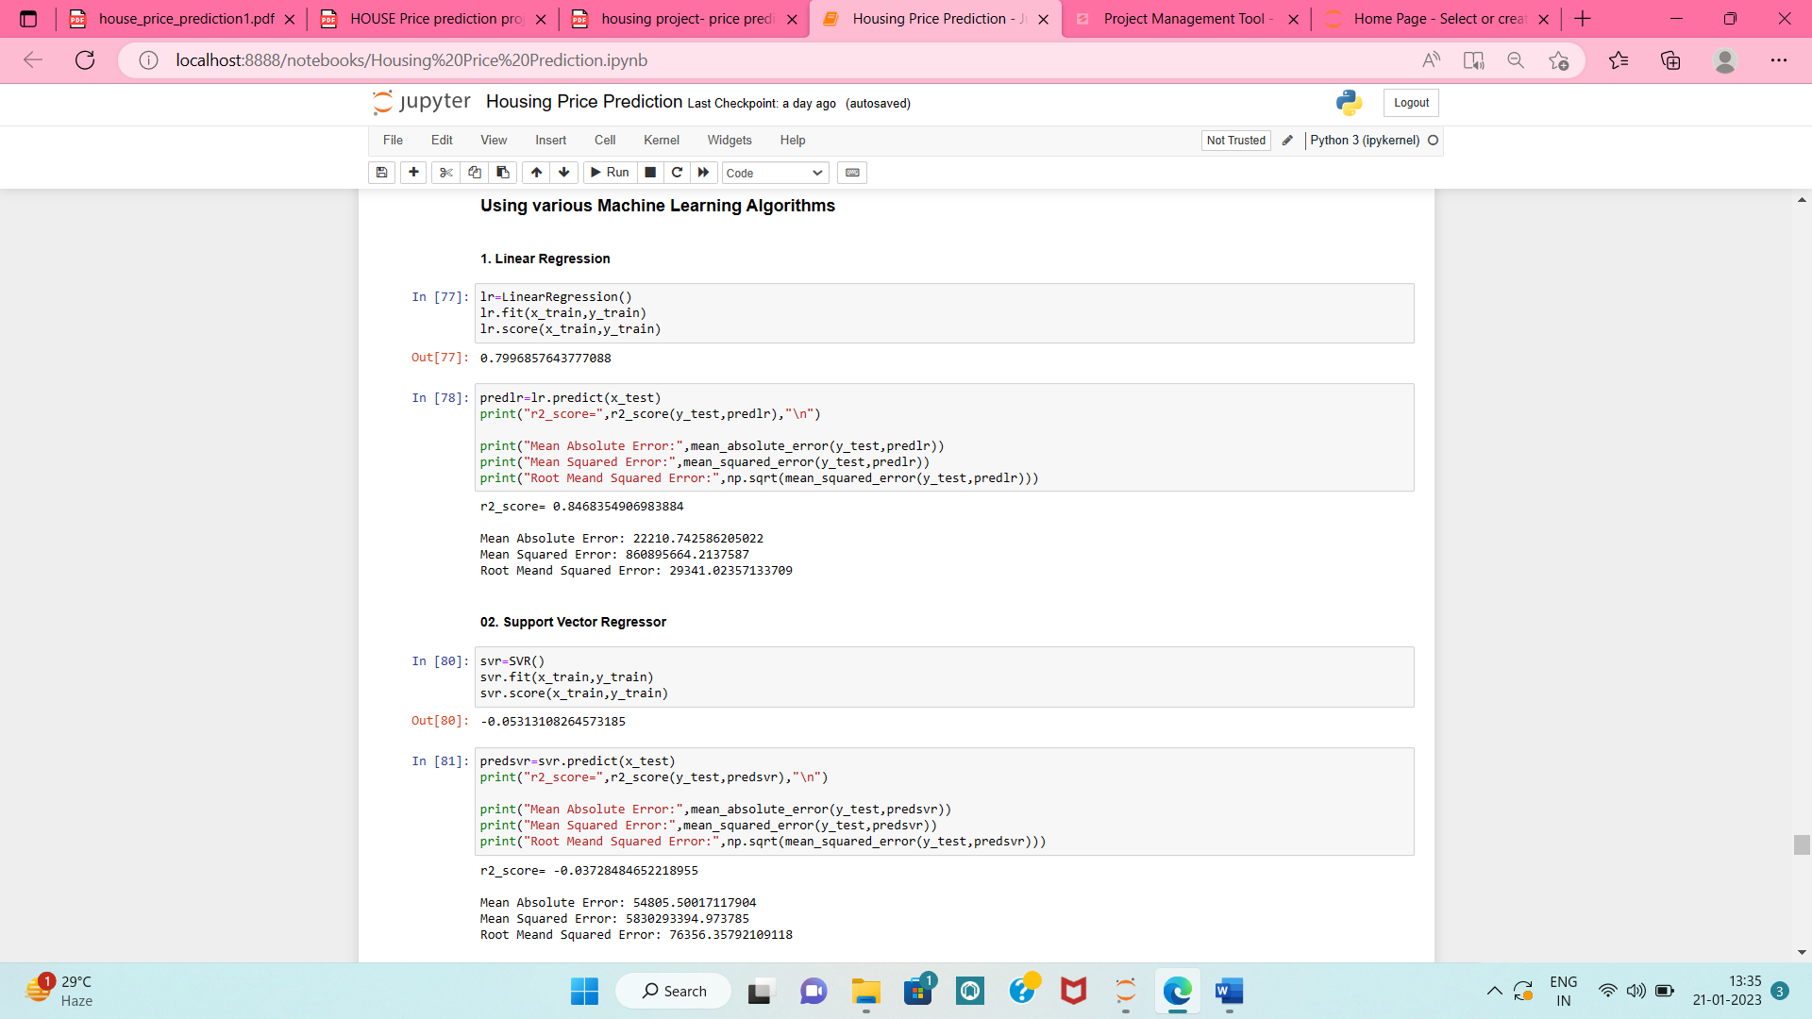
c) Running and Evaluating selected models

Slide 26
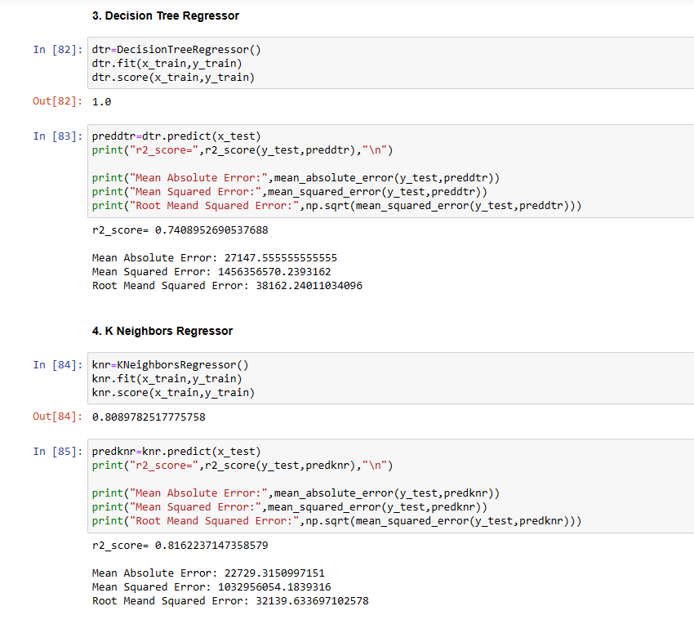

Slide 27


Slide 28
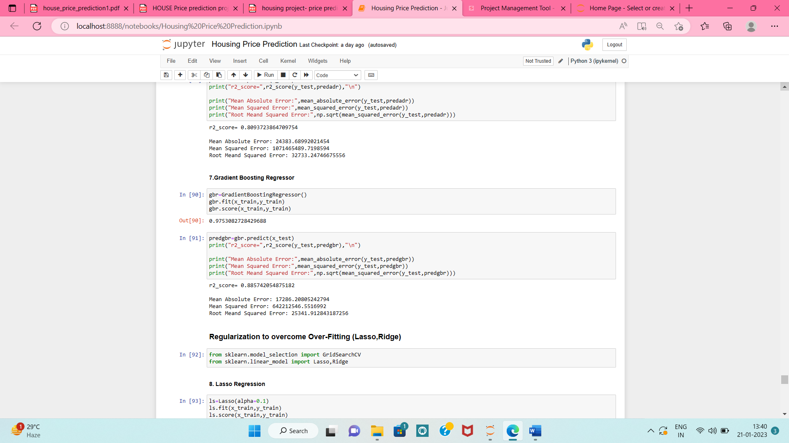

Slide 29
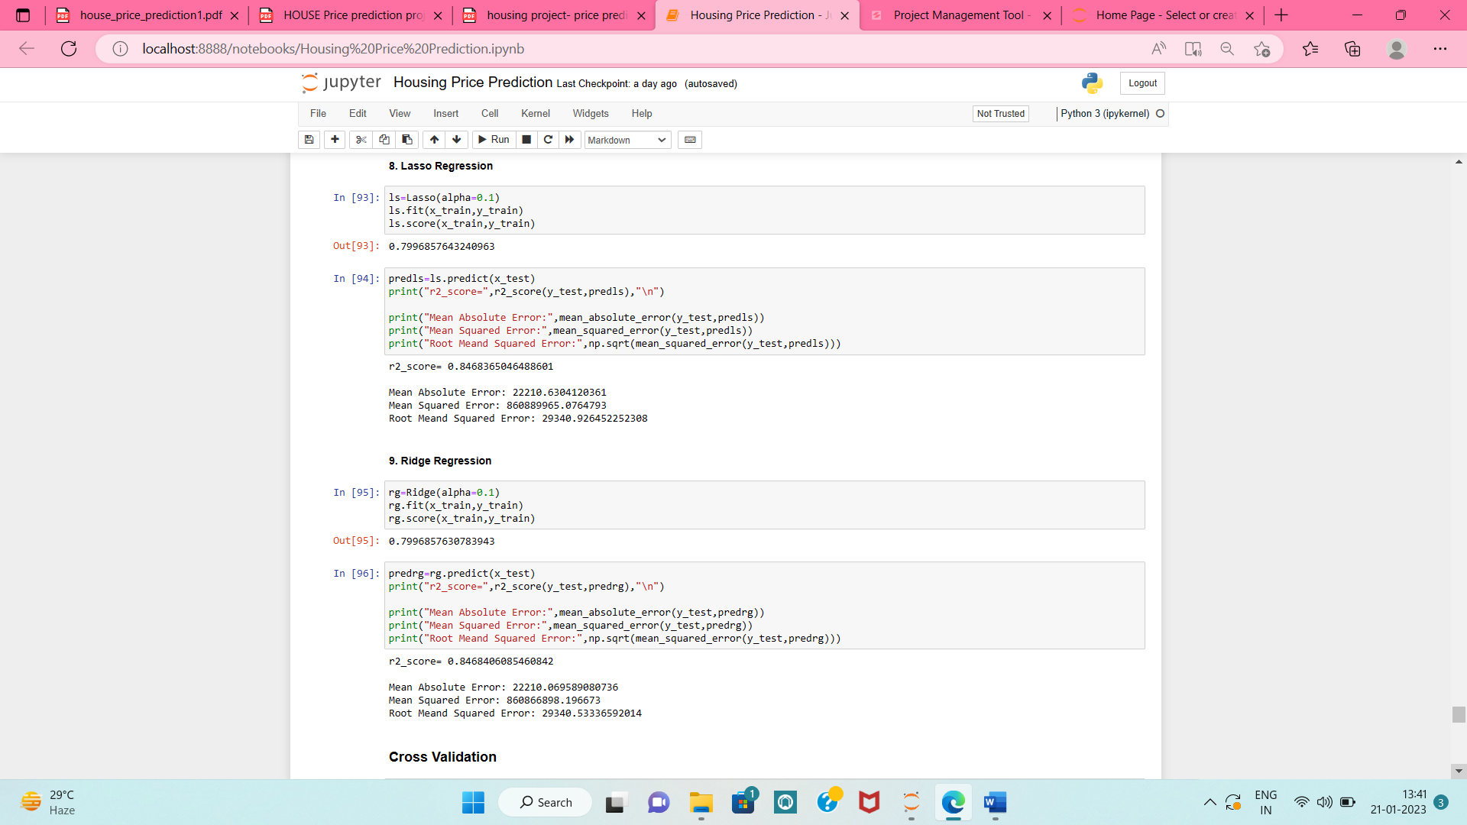

Slide 30
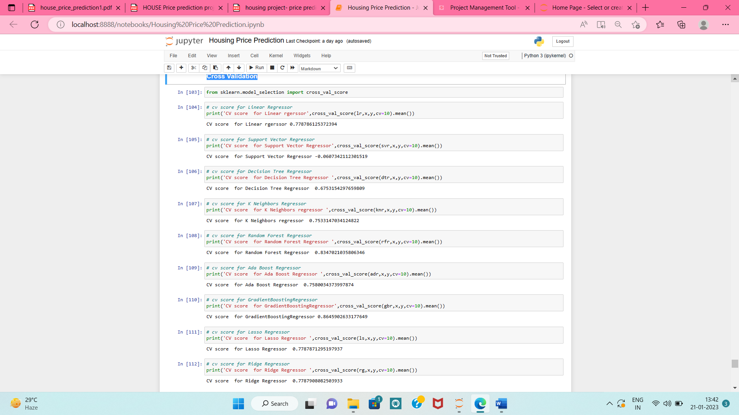
d) Cross Validation: Took k-folds=10

Slide 31
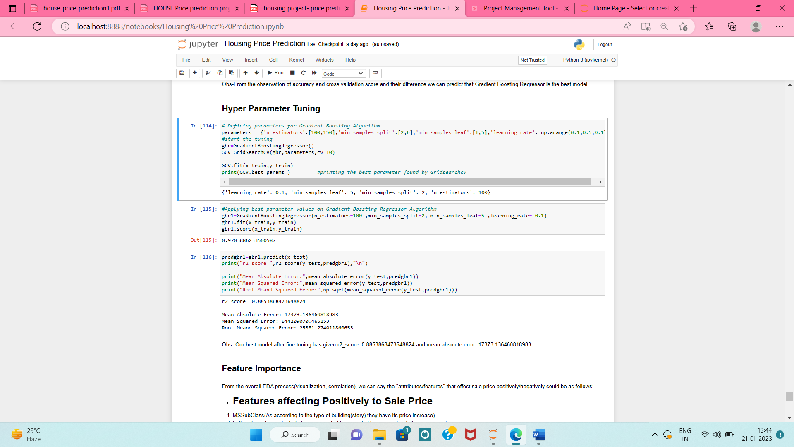
e) Hyper Parameter Tuning:
As Gradient Boosting Regressor has given the best r2_score and least errors, se;ecting it as our best model and performing hyper tuning on it to further improve the performance

Slide 32
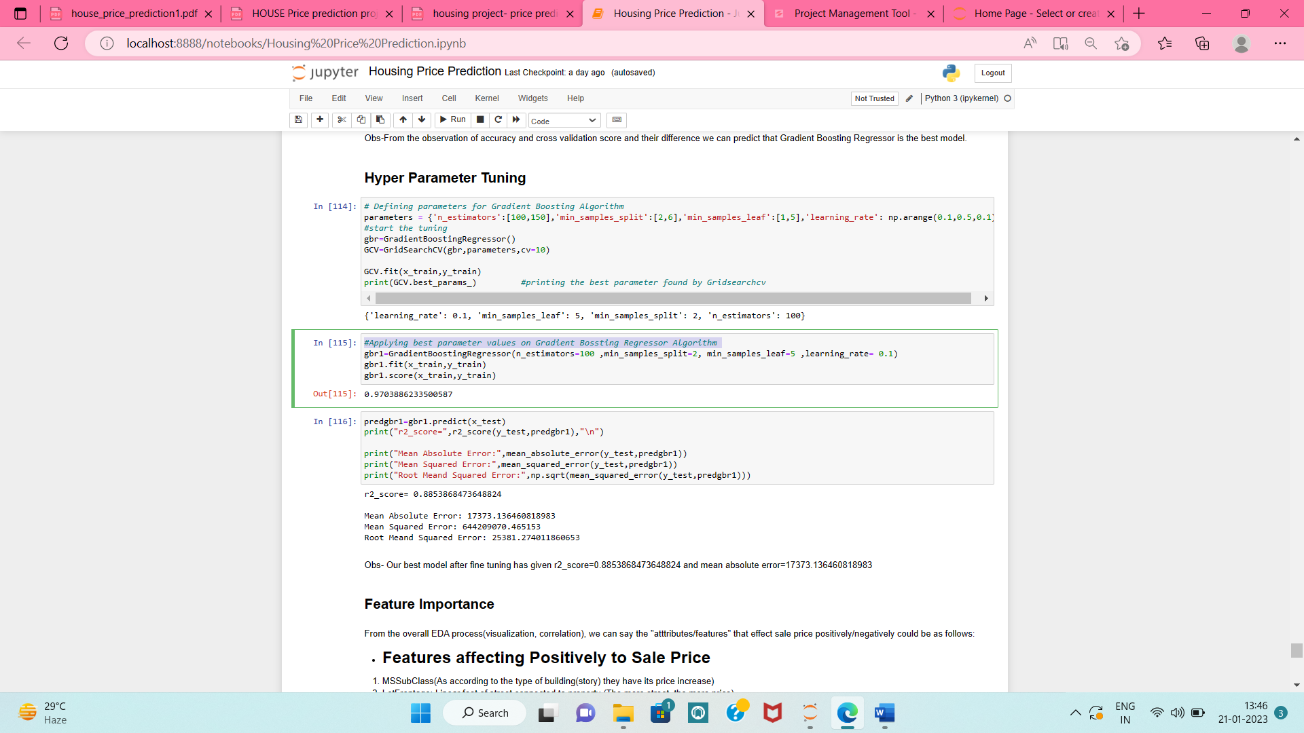
Applying best parameter values on Gradient Boosting Regressor Algorithm and checking the r2-score and errors

Slide 33
Feature Importance
1.Features affecting Positively to Sale Price:
MSSubClass (As according to the type of building(story) they have its price increase)
LotFrontage: Linear feet of street connected to property (The more street, the more price)
LotArea: Lot size in square feet(The larger the area, higher the price)
TotalBsmtSF: Total square feet of basement area(The larger the basement area, higher the price)
TotRmsAbvGrd: Total rooms above grade(More the number of rooms, higher the price, and they do owe properties with max 6-7-8 rooms)
YearBuilt: Original construction date (As they do owe lots of new properties or old properties that are remodelled,they can get good sale price)
KitchenQual: Kitchen quality(Most of the properties have good kitchen quality)
FullBath: Full bathrooms above grade
GarageCars: Size of garage in car capacity(They do own max properties that have atleast 2-3 cars area for garage and min 1)

Slide 34
Feature Importance
2. Features affecting Negatively to Sale Price:
OverallQual:(Since the maximum properties they owe have average quality of material used,it is negatively affecting the sale price)
OverallCond:(Again,the maximum properties they owe have average condition it is negatively affecting the sale price)
LotShape:(Since they have half of the properties whose shape is irregular, it is negatively affecting the sale price)

Slide 35
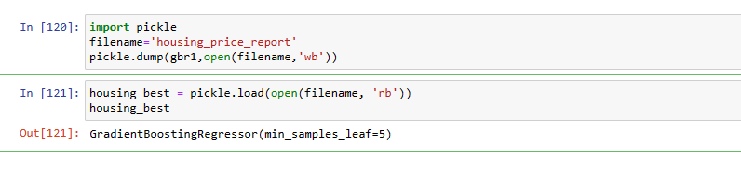
Results
Our best model i.e. Gradient Boosting Regressor, after fine tuning has given:
r2_score=0.8853868473648824 and
mean absolute error=17373.136460818983
Saving the best model

Slide 36
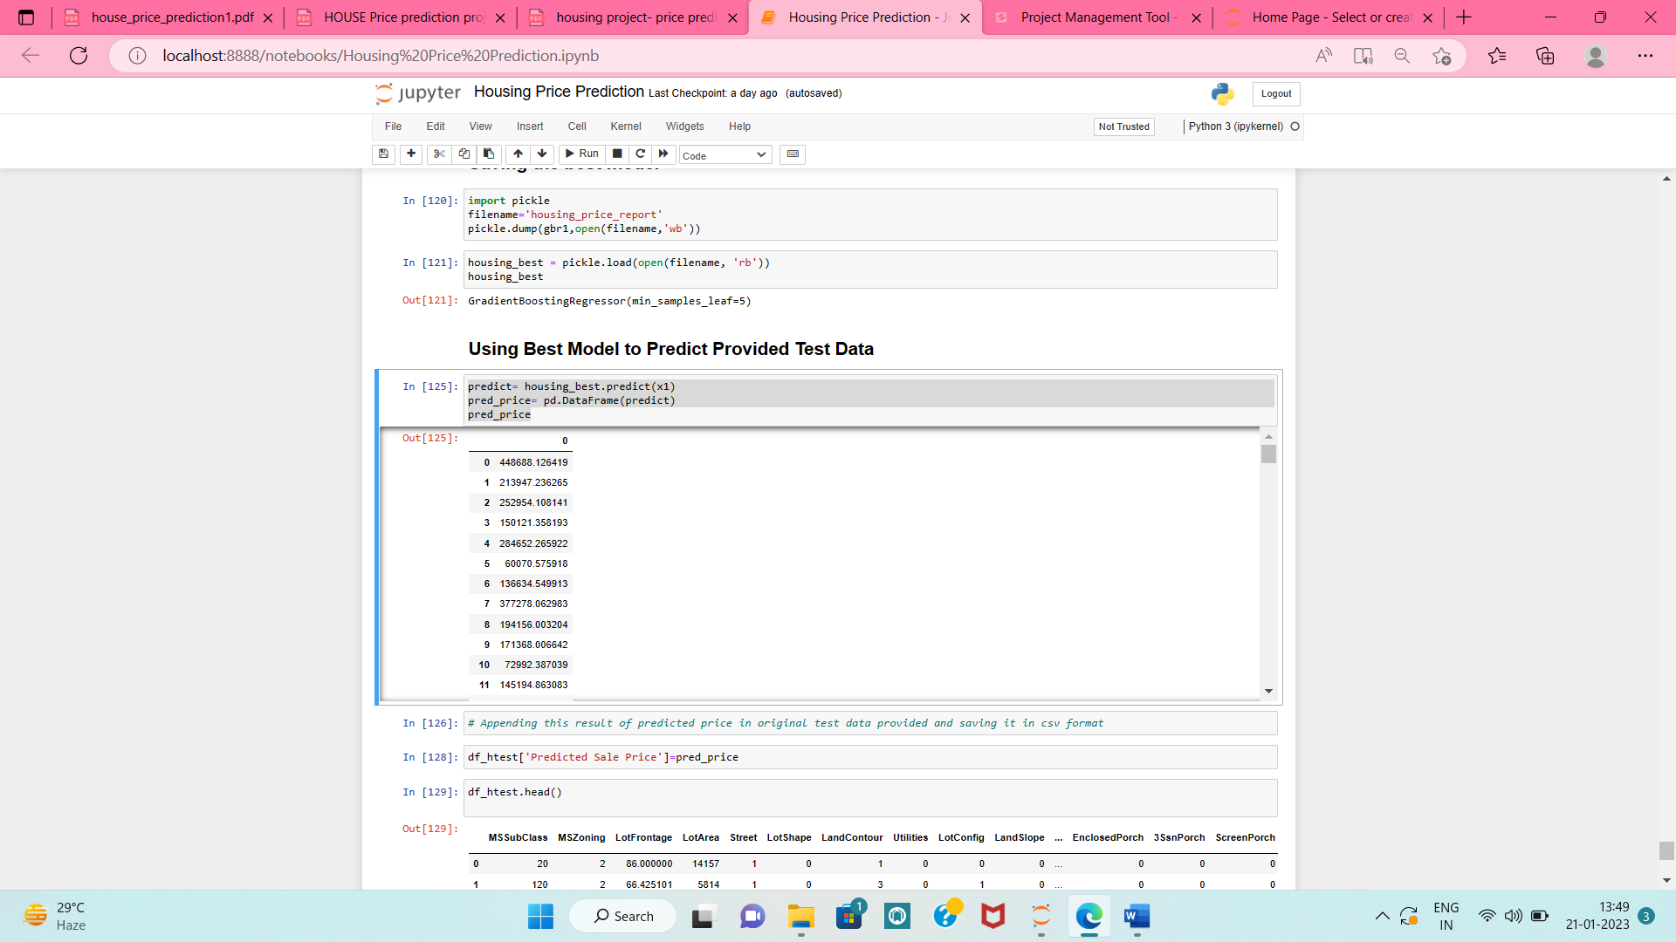
Using Best Model to Predict Provided Test Data

Slide 37
Conclusion:
In this project, we built several regression models to predict the price of any house given some of the house features.
We evaluated and compared each model to determine the one with highest performance.
In this project, we followed the data science process starting with getting the data, then cleaning and pre-processing the data, followed by visualizations and exploring the data and building models, then evaluating the results through Regularization and Cross-Validation.
As a recommendation, we advise to use this model (or a version of it trained with more recent data) by people who want to buy a house in the area covered by the dataset to have an idea about the actual price.
The model can also be used with datasets that cover areas containing the same features. We also suggest that people take into consideration the features that were deemed as most important as provided above; this might help them estimate the house price better.

Slide 38
Limitations of this work and Scope for Future Work
There are many things that can be tried to improve the models’ predictions. We can create and add more variables, try different models with different subset of features and/or rows, etc.
The `biggest limitation in the dataset was that not all categories of a particular feature were available in the training data. So, if there is a new category in the test data/new data, the model would not be able to identify the new categories.

